Slide 1
Cardano Incentives
Ideas From Cerkoryn
18 March 2025

Slide 2
Summary
Key Challenges
Ideas
Change minPoolCost to minMargin
Use All Rewards for Active Stake
Expiring Delegation Certificates
Pledge Leverage
Demurrage
Leios / Testnet / Mithril Incentives

Slide 3
Key Challenges
Decentralize stake & voting power
Address delegation mobility (sticky stake)
Increase pledge importance
Improve rewards sustainability
Promote fairness for smaller pools
Decentralization
Sticky Stake
Pledge
Rewards Sustainability
Fairness

Slide 4
Change minPoolCost to minMargin
The flat, minimum fee imposed by minPoolCost proportionally pays more share of block rewards to small pools.
Small Pool Example:
100 ADA minPoolCost
1,000 ADA epoch reward
Results in a 10% margin
Big Pool Example:
100 ADA minPoolCost
10,000 epoch ADA reward (bigger pool == bigger reward)
Results in a 1% margin
This paradoxically favors operators with more stake, causing them to outcompete small pools due to economies of scale.
Using the above example, a big pool can split into several small pools and earn 10x the fee!
Splitting to farm the fee can be more profitable than increasing pledge in a single pool to earn more rewards as intended.
The fee is paid per epoch (not per block) so small pools struggling to make consistent blocks have poor ROI for delegators.
Decentralization
Sticky Stake
Pledge
Rewards Sustainability
Fairness
Notes:
Small pools have very little flexibility. SPOs with lots of ADA can split stake to put in just enough to mint blocks consistently and look attractive, yet still farm the fee. The sweet spot would be for them to aim to mint one block per epoch.

Slide 5
Change minPoolCost to minMargin
Using a percent-based minMargin instead of the flat minPoolCost fixes this issue almost entirely, as each pool will have the same proportion of minimum fees no matter the size
Small Pool Example:
10% minMargin parameter
1,000 ADA reward
Results in a 100 ADA fee
Big Pool Example:
10% minMargin parameter
10,000 ADA reward (bigger pool == bigger reward)
Results in a 1,000 ADA fee
This eliminates the advantage of splitting a large amount of stake into smaller pools, since it won’t affect the proportion of fees taken
SPOs previously splitting to farm the fee are expected to…
Converge into a smaller number of pools to minimize operating costs
Increase pledge to maintain profit
Decentralization
Sticky Stake
Pledge
Rewards Sustainability
Fairness

Slide 6
Use All Rewards for Active Stake
Decentralization
Currently…
At epoch turnover, the protocol forms a rewards pot by taking a fixed percentage (Rho) of the ADA still in the reserve
Next, a cut is sent to the treasury (Tau)
At this point the protocol considers how much ADA is staked vs. unstaked, with the proportional amount of unstaked ADA being returned to the reserve
The remainder of the rewards pot is then distributed proportionally to SPOs and their delegators
Sticky Stake
Pledge
Rewards Sustainability
Fairness
Notes:
This behavior is not documented in the Formal Spec for Shelley. It is only mentioned in the design document (page 35)

Slide 7
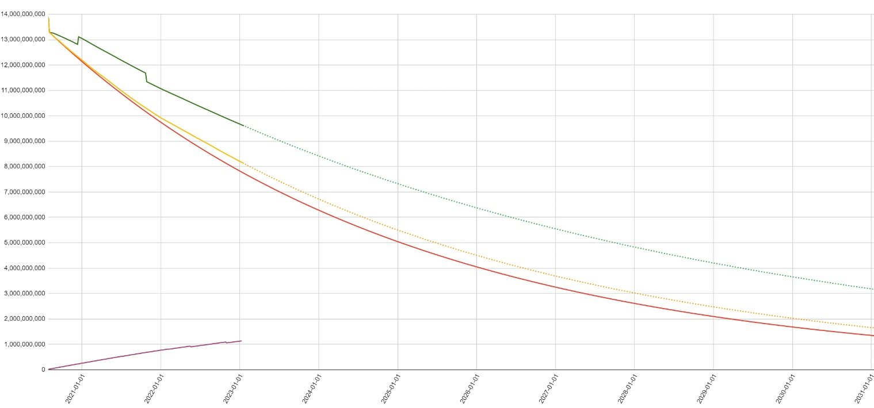
Use All Rewards for Active Stake
Implications of doing things in this order…
Treasury cut is applied to both staked and unstaked ADA, meaning the realized tax is actually 33% for ADA delegators even though Tau is set to 20%
The true rate of monetary expansion is actually about ~0.2%, even though Rho is set to 0.3%
Decentralization
Sticky Stake
Red = ADA in reserves if we follow Rho.
Green = Actual amount of ADA in reserves.
Pledge
Rewards Sustainability
Fairness
Notes:
This is good news because it means ADA inflation has been less than planned and we actually have more rewards on the table if we want them!

Slide 8
Use All Rewards for Active Stake
This idea suggests using all ACTIVE staked ADA and ignoring unstaked ADA for the calculation.
At epoch turnover, the protocol forms a rewards pot by taking a fixed percentage (Rho) of the ADA still in the reserve
Next, a cut is sent to the treasury (Tau)
At this point the protocol considers how much ADA is staked vs. unstaked, with the proportional amount of unstaked ADA being returned to the reserve
The remainder of the rewards pot is then distributed proportionally to SPOs and their delegators
Decentralization
Sticky Stake
Pledge
Rewards Sustainability
Fairness

Slide 9
Use All Rewards for Active Stake
Expected outcomes of this change…
True monetary expansion will actually match what the Rho parameter is set to (0.3% per epoch)
True treasury tax to delegators will actually match what the Tau parameter is set to (20% per epoch)
All ADA stake pools and delegators will receive higher rewards immediately.
If the total amount of ADA participating in consensus decreases, then rewards increase creating a balancing effect for participation
Pledge might have marginally more importance as a multiplier
One potential tradeoff…
Possibility of malicious SPOs censoring delegation transactions to prevent global participation in order to keep their rewards higher
Not difficult to detect, but how can we stop them if they decide to?
Decentralization
Sticky Stake
Pledge
Rewards Sustainability
Fairness

Slide 10
Expiring Delegation Certificates
The problem:
If someone permanently loses access to their keys (e.g. death, lost seed, bugs), that ADA remains delegated but can’t ever be spent again
Because the funds can’t be moved or redelegated—even if the dRep or SPO acts maliciously—this stake is “stuck”
This “sticky stake” continues earning rewards (both from the reserve and transaction fees), compounding over time
It’s nearly impossible to measure exactly how much ADA is lost in this way
As ADA’s price grows, it becomes more difficult for fresh delegation to outweigh this ever‐accumulating stake
Decentralization
Sticky Stake
Pledge
Rewards Sustainability
Fairness

Slide 11
Expiring Delegation Certificates
How urgent is this issue?
Let’s assume that 2% of circulating ADA is forever lost each year
This lost ADA remains delegated, accumulating 3% rewards annually
After 25 years, ~48.5% of ADA could be lost forever
With $10 ADA, that’s $21.825 billion dollars!
After 50 years, ~97% of ADA could be lost forever
With $10 ADA, this would be $43.65 billion dollars!
Additionally, the growing portion of lost ADA could centralize influence in certain stake pools or dReps that wield it as stake/voting power
Decentralization
Sticky Stake
Pledge
Rewards Sustainability
Fairness
Notes:
Empathize that this is napkin math.

Slide 12
Expiring Delegation Certificates
Proposed solution:
Add an “expiration epoch” to every delegation certificate that is adjustable via protocol parameter
Set initial expirations long (e.g. 5–10 years) so existing “permanent” delegations gradually expire
If a user doesn’t renew before expiry, their wallet automatically becomes undelegated
Wallets can provide simple reminders or bundle renewal with a normal transaction for a smooth UX
Decentralization
Sticky Stake
Pledge
Rewards Sustainability
Fairness
Notes:
This has fantastic synergy with the proposal to use only active stake in the rewards calculation, because when certificates expire, the rewards that were being paid out to dead addresses are now being sent to active wallets.

Slide 13
Pledge Leverage
The problem:
k parameter
k was meant to encourage k equally sized pools, but this hasn’t materialized
SPOs regularly split into many different pools, bypassing the intent behind k
Instead of converging on k pools of roughly equal size, we see a few large operators dominating
The design assumed each entity would run only one pool and there is an argument to be made that running more than that constitutes a Sybil attack
a0 parameter
Pledge has had a relatively insignificant effect on rewards earned with the exception of pools very close to the saturation limit, undermining its importance
Billions of ADA is currently staked in pools with nearly 0 pledge, representing massive control without any “skin in the game”
Decentralization
Sticky Stake
Pledge
Rewards Sustainability
Fairness

Slide 14
Pledge Leverage
How can we discourage pool splitting and encourage SPOs to increase their pledge?
Proposed solution:
Introduce a new parameter called L, representing pledge leverage
The general idea is that the amount of pledge will be used to determine what the saturation cap of a pool will be
Four schools of thought:
Keep a0 and k, but additionally use L to further refine saturation limit (CIP-50)
Keep a0 but delete k, use L exclusively to calculate saturation limit
Delete k and a0, use L exclusively to calculate saturation limit
Keep k but delete a0, use L and k together to refine saturation limit
Decentralization
Sticky Stake
Pledge
Rewards Sustainability
Fairness

Slide 15
Pledge Leverage
#1
CIP-50 - Add L, keep a0 and k
Pool saturation will be determined by both L and k
If a pool has a high pledge, it can potentially handle more stake before hitting diminishing returns—but only up to the limit that k sets for the network
a0 adjusts the reward curve so that higher pledge levels boost rewards (in addition to raising the saturation limit)
Decentralization
Sticky Stake
Pledge
Rewards Sustainability
Fairness
Notes:
K used as network-wide “soft cap”, L is used as an individual pool’s “hard cap”

Slide 16
Pledge Leverage
#2
Add L, keep a0, delete k
Pool saturation will be determined exclusively for each individual pool in proportion to the amount of pledge in it
A pool can theoretically have infinite stake, so long as they can put up enough pledge to justify it
a0 adjusts the reward curve so that higher pledge levels boost rewards.
Decentralization
Sticky Stake
Pledge
Rewards Sustainability
Fairness
Notes:
As an example, if you want your saturation cap to be 50 billion ADA (above 45 billion supply) and we have L set to 10, then that would require a 5 billion ADA pledge.

Slide 17
Pledge Leverage
#3
Add L, delete k and a0
Pool saturation will be determined exclusively for each individual pool in proportion to the amount of pledge in it
A pool can theoretically have infinite stake, so long as they can put up enough pledge to justify it
Everybody receives the same reward RATE no matter the pledge
Examples using L set to 10:
SPO pledges 10k ADA, saturated at 100k stake = 5% yield that 100k.
SPO pledges 100k ADA, saturated at 1M stake = 5% yield on that 1M.
Decentralization
Sticky Stake
Pledge
Rewards Sustainability
Fairness
Notes:
Small pools would get exactly the same yield and there would be no reason for a large pool to split. They would have added operating costs for no benefit.

Slide 18
Pledge Leverage
#4
Add L, keep k, delete a0
Pool saturation will be determined by both L and k
If a pool has a high pledge, it can potentially handle more stake before hitting diminishing returns—but only up to the limit that k sets for the network
Everybody receives the same reward RATE no matter the pledge
Decentralization
Sticky Stake
Pledge
Rewards Sustainability
Fairness
Notes:
Combination of the previous CIP-50 and the previous slide(#1 and #3). Haven’t put a lot of thought into this one yet.

Slide 19
Demurrage
The problem:
Eventually the reserves will be depleted. Will transaction fees alone be enough to sustain SPOs?
If we need more, the only other popular solution is tail emissions, which is inflationary (and controversial)
On the contrary, lost ADA that is removed from circulation never returns, which is deflationary
Decentralization
Sticky Stake
Pledge
Rewards Sustainability
Fairness

Slide 20
Demurrage
The solution:
UTxOs that have not been spent in a very long time (i.e., 10+ years) can be slowly reclaimed to SPOs/delegators.
Can combine it with “Expiring Delegation Certificates” and have demurrage only apply to undelegated UTxOs (in addition to being inactive for many years)
Results in a perfectly stable total supply of ADA.
Supplements SPO/delegator rewards.
Ergo blockchain currently uses this with the eUTxO model to great success
Penalizes inactivity (as opposed to Tx fees, which penalize activity)
Tradeoff:
Reclaiming UTxOs that belong to someone else is controversial and probably unconstitutional.
Technically difficult to implement
Decentralization
Sticky Stake
Pledge
Rewards Sustainability
Fairness

Slide 21
Leios / Testnet / Mithril Incentives
Ouroboros Leios
Different kinds of blocks to produce:
Input Block
Ranking Block
Endorsement Block
Testnet
SPOs currently run testnet infrastructure for free.
Maybe this would be better paid from the budget?
Mithril
Participation has been slow, arguably because there is no incentive to be a Mithril signer
Decentralization
Sticky Stake
Pledge
Rewards Sustainability
Fairness

